Slide 1
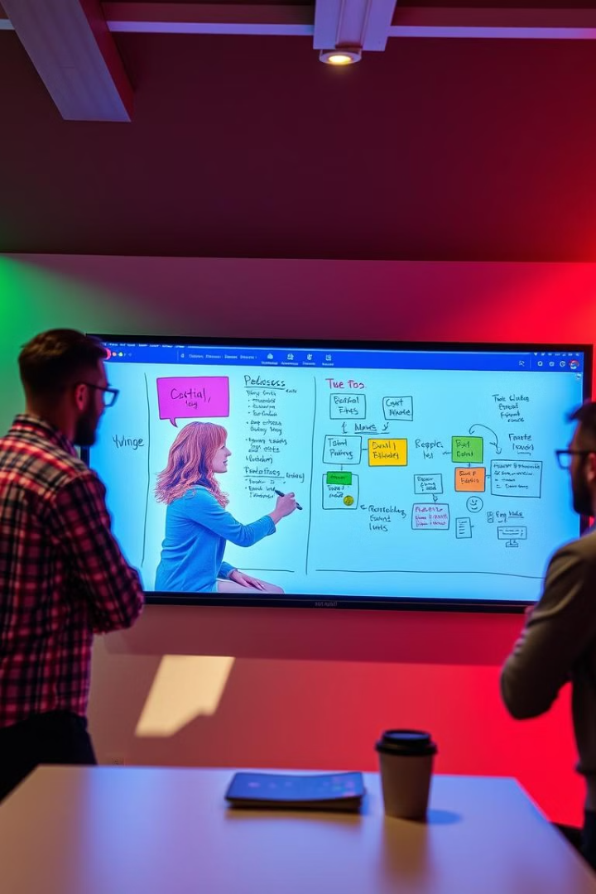
Doodle Dash: Real-Time Collaborative Whiteboard
Solving the remote collaboration challenge for teams and individuals by leveraging Socket.IO, Node.js, and JavaScript for a dynamic solution.

Slide 2

The Problem: Remote Collaboration Bottlenecks
Distributed Teams
Existing Solutions
Need
Struggling with visual brainstorming and planning.
(Miro, Microsoft Whiteboard) can be complex or costly.
For simple, real-time, multi-user whiteboard functionality.

Slide 3




The Challenge: Building Real-Time Collaboration
State Synchronization
Efficiently synchronize data across multiple users.
WebSocket Handling
Manage WebSockets for low-latency communication.
Scalability
Support a growing number of concurrent users.

Slide 4

Introducing Doodle Dash: The Solution
Web-Based
Socket.IO
Real-time collaborative whiteboard application.
Built with for seamless, bi-directional communication.
Lightweight
Easy-to-use interface for enhanced productivity.

Slide 5
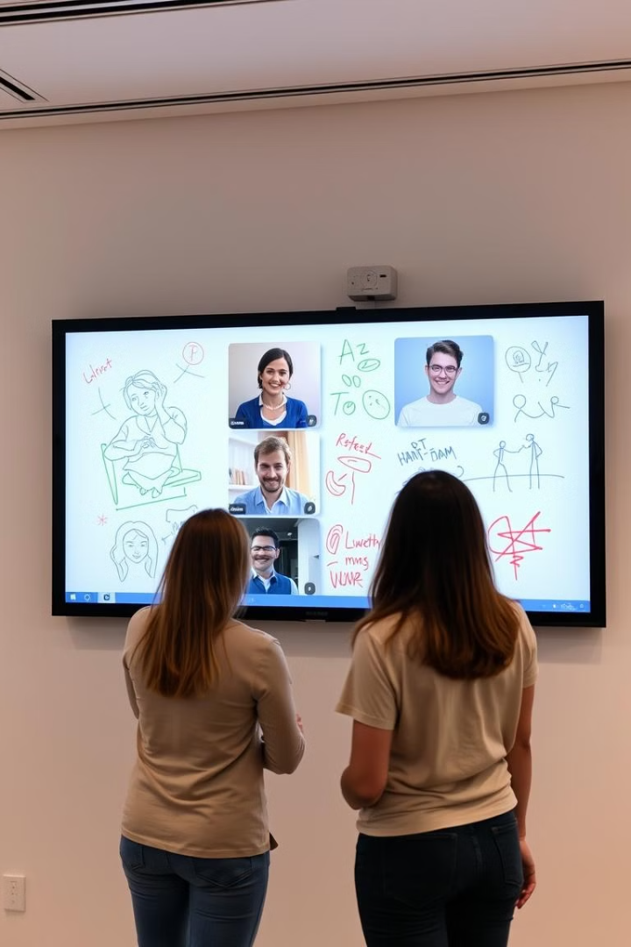




Key Features & Functionality
Real-Time Drawing
Sketching capabilities.
Multi-User Support
Synchronized updates.
Simple UI
Pen, color, and eraser tools.
Node.js
Efficient event handling.

Slide 6
Technical Architecture: Socket.IO and Node.js
Socket.IO
Node.js
JavaScript
Enables real-time, bidirectional communication between client and server.
Provides a scalable, event-driven backend environment.
Handles client-side drawing and interaction logic.

Slide 7

Impact and Benefits
Seamless Collaboration
For teams and students.
Fosters Creativity
Enhances visual thinking.
Cost-Effective
Alternative to existing solutions.
Demonstrates Skills
Advanced web development abilities.

Slide 8

Conclusion: The Future of Collaborative Whiteboarding
1
2
Addresses Need
Showcases Power
Critical for remote teams.
Of Socket.IO and Node.js.
3
Opens Opportunities
For development and expansion.

